Slide 1
Polynomial regression

Slide 2
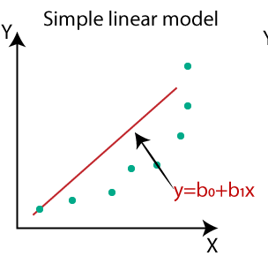
What is need of polynomial regression?
In simple linear regression algorithm only works when the relationship between the data is linear But suppose if we have non-linear data then Linear regression will not capable to draw a best-fit line and It fails in such conditions.
consider the below diagram which has a non-linear relationship and you can see the Linear regression results on it, which does not perform well means which do not comes close to reality.
polynomial regression can overcome this problem, which helps identify the curvilinear relationship between independent and dependent variables.

Slide 3
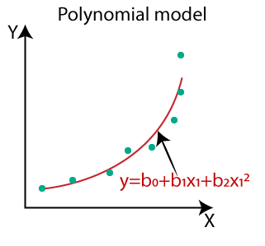
Polynomial regression is a form of Linear regression. Hence, adding some polynomial terms in linear regression to convert it into Polynomial regression.
The equation of polynomial regression is
Y=B0+B1*X1+B2*x₁²+…+Bn*x₁^{n}
The degree(n) of order which to use is a Hyperparameter, and we need to choose it wisely. But using a high degree of polynomial tries to overfit the data and for smaller values of degree, the model tries to underfit so we need to find the optimum value of a degree.
From the graph we can understand the how out polynomial regression algorithm find curved relation ship between dependent and independent variable and give best solution

